Slide 1
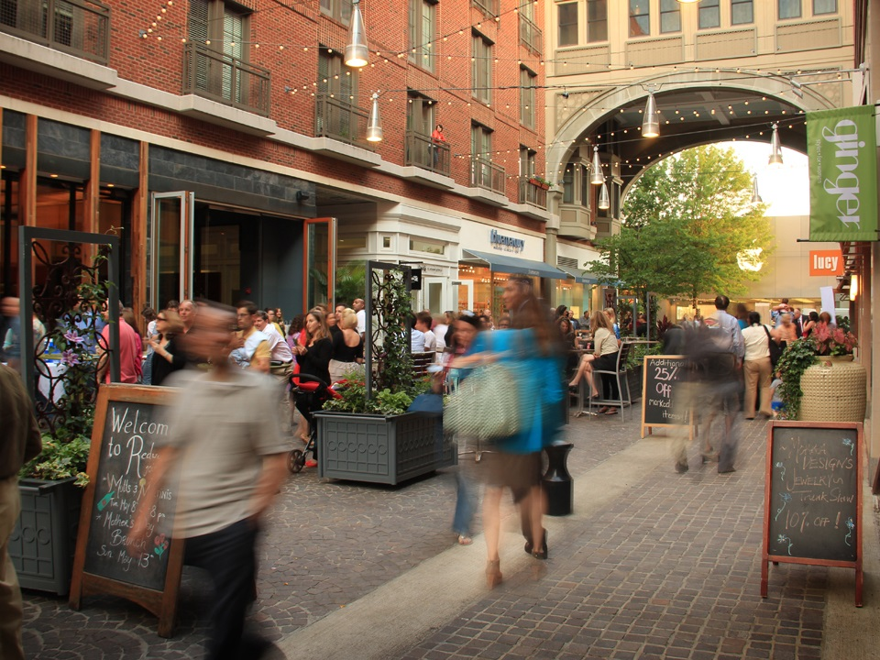
St. Mary’s County Airport Innovation District Master Plan
The Commissioners of St. Mary’s County
Calvert-St. Mary’s Metropolitan Planning Organization
November 5, 2019
Torti Gallas + Partners
Toole Design Group

Slide 2
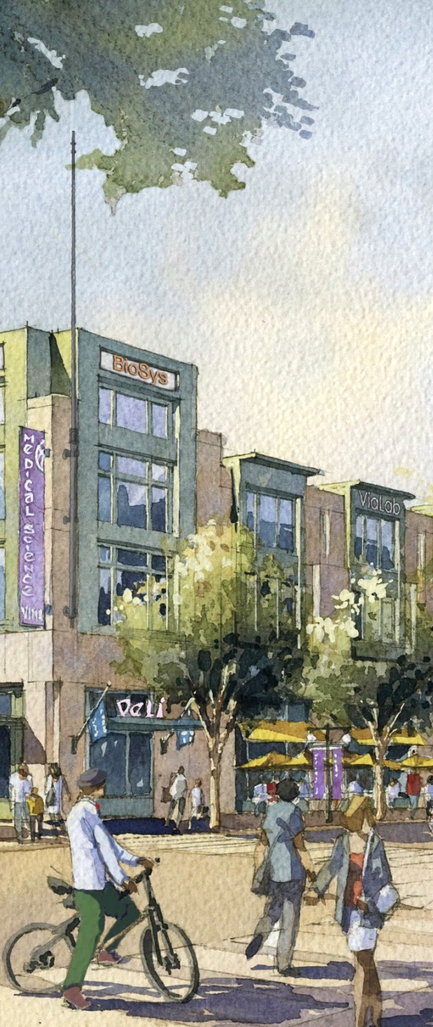
Process
1. Analysis
2. Stakeholder Meetings
3. Community Meeting 1
4. Concept Plan Alternatives
5. On-Site Working Session
6. Revised Plan
7. Community Meeting 2
8. Final Plan Report
5/15-16
6/25
8/25
9/30
2

Slide 3
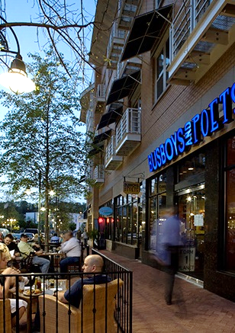
What is an Innovation District?
“Innovation happens over beer, coffee, and conversation!”
Lanny Bates, Director of Campus Development - Brookhaven National Lab
3

Slide 4
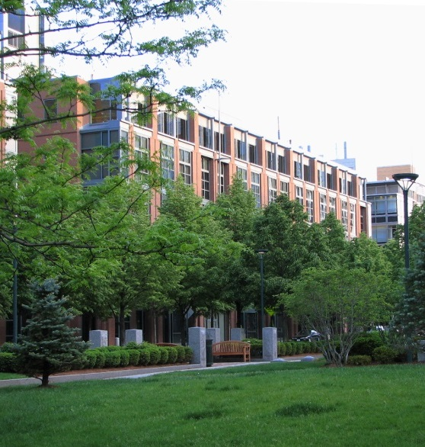
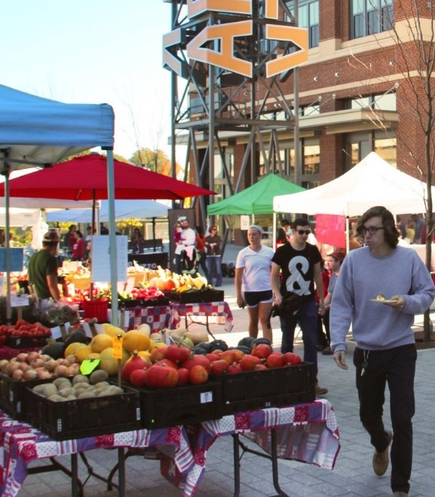
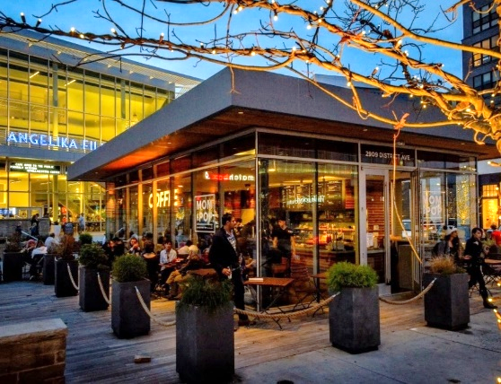
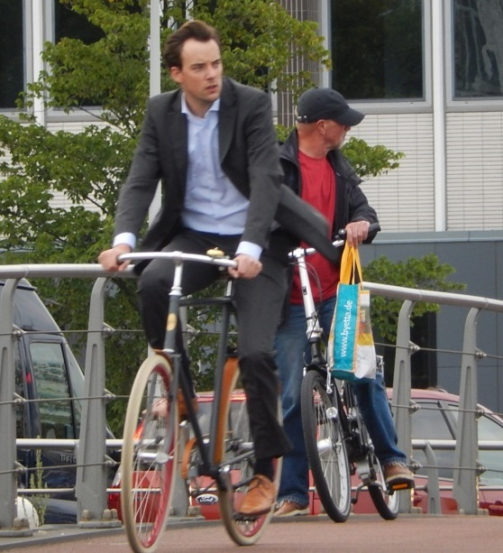
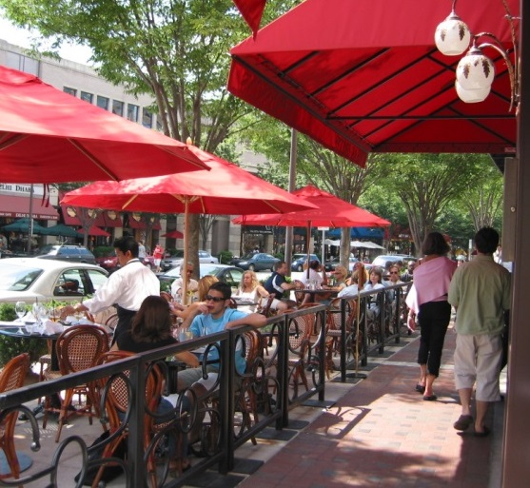
Innovation Districts
“Geographic areas where leading-edge anchor institutions and companies cluster and connect with start-ups, business incubators, and accelerators. They are also physically compact, transit accessible, and technically-wired and offer mixed-use housing, office, and retail”
Adapted from “The Rise of Innovation Districts: A New Geography of Innovation in America”,
Bruce Katz and Julie Wagner – Brookings Metropolitan Policy Program
4

Slide 5
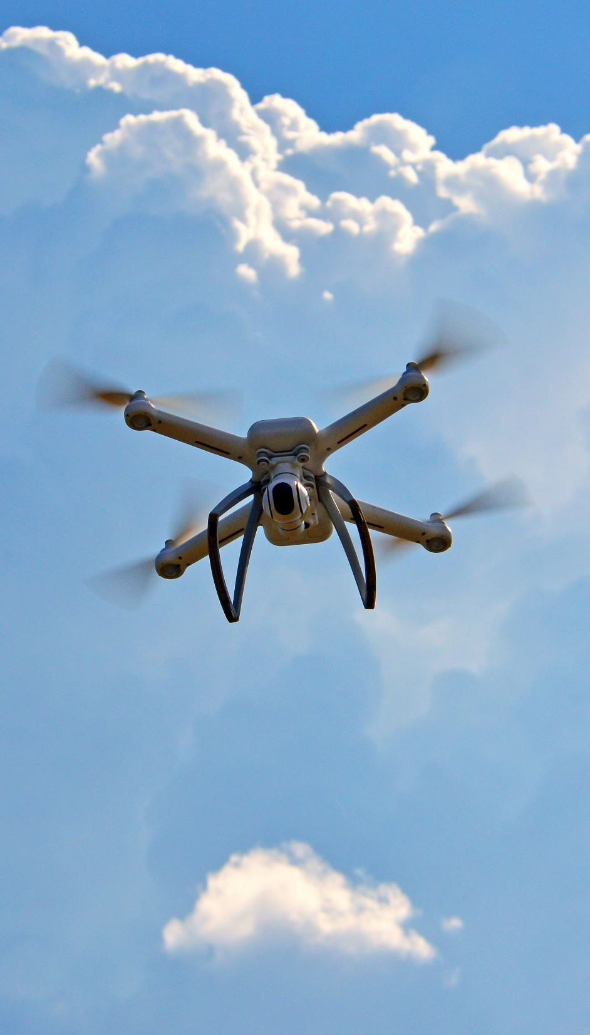
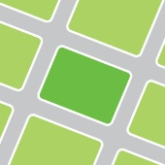
Innovation Ecosystem
Economic Assets Firms, Institutions, and Organizations
Physical Assets Buildings, Open Spaces, Streets, and Infrastructure
Networking Assets Relationships, Opportunities, and Activities
“[It’s] the synergistic relationship of innovation assets that facilitate idea generation and accelerate commercialization”
Adapted from “The Rise of Innovation Districts: A New Geography of Innovation in America”,
Bruce Katz and Julie Wagner – Brookings Metropolitan Policy Program
5

Slide 6
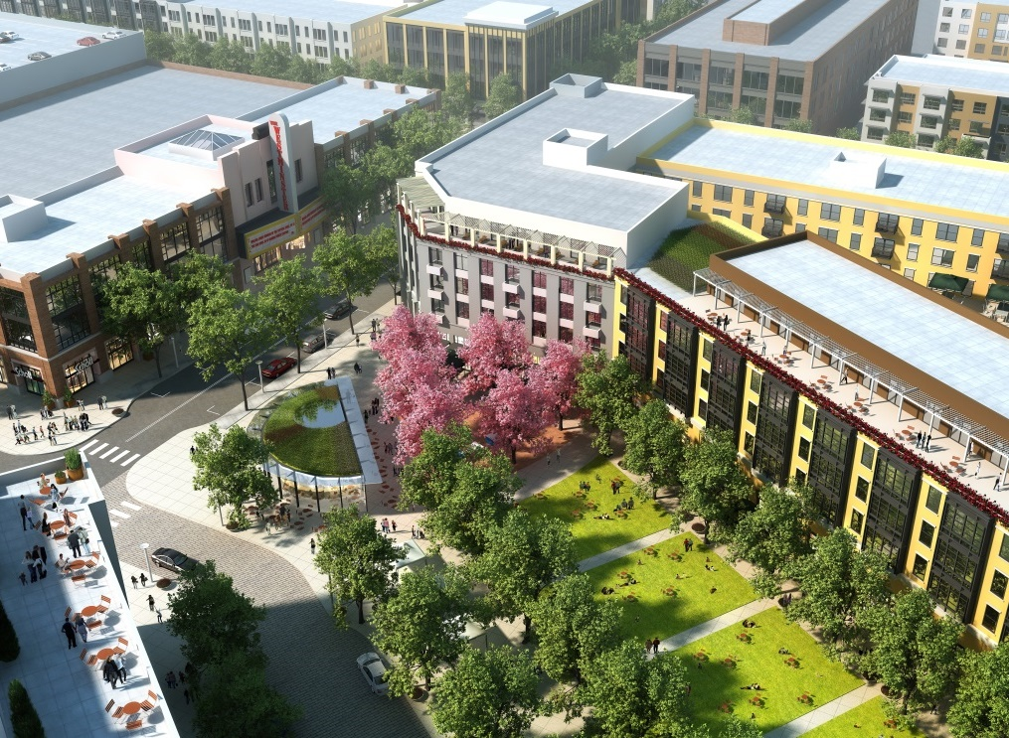
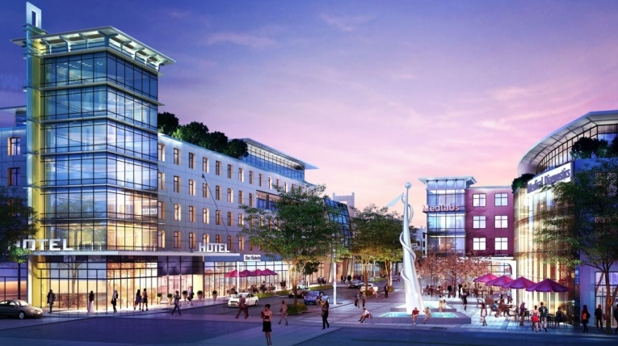
Benefits
Grows jobs aligned with disruptive forces in the economy
Grows better and more accessible jobs
Empowers entrepreneurs creating jobs & economic growth
Responds to market trends and preference for mixed-use compact walkable places
Creates strong foundation for the commercialization of ideas and creation of businesses
Increases competitiveness for economy and talent
Promotes knowledge spillover
Provides efficient access/sharing of legal advice, sophisticated equipment, special facilities, etc.
Increases efficiency of ex. infrastructure
Reduces carbon emissions
Helps increase revenues
6

Slide 7
St. Mary’s Innovation District
7

Slide 8
Unique Facilities
University System of Maryland at Southern Maryland
Airport
Runway Access
Extending Runway for Larger Plane Access
Focus on Highly Developed & Comprehensive Academic and Professional Educational Opportunities
Graduate & Upper Undergraduate
Technology, Teaching, Management, Health, other professional
New Building Dedicated to Autonomous Research Development, and Education
TechPort
Business Technology Incubator
Targets Startup and Early Stage Companies
Specialized in Unmanned and Autonomous Systems
IMPAX
Facilitate Technology Transfer
Work with Industries, Schools, Public
Partnered with Navy and Georgia Tech Research Institute
UMD UAS Test Site
Research – Unmanned Flight
Test Fly Drones
Civil and Commercial (some military)
Existing Industry
Aviation Aeronautic Modification & Repair
Cyber Technology
Other Research

Slide 9
What We’ve Heard
Maintaining airport operations is a priority
More (and larger) hangars with taxiway access are needed
Airport is isolated and hidden - Let people know where it is, what’s happening
Observation area is desirable
Could demonstrate tech and innovation on-site
Need to diversify economic drivers
Need to attract and retain residents and employees, especially young professionals
Need a variety of housing types
Need to connect education with tech jobs
Need improved connections and circulation
Improve walkability/Add sidewalks
Create safe and connected network of trails, paths, and transit lanes
Need amenities – Food, Drink, Services
Need places for gathering and relaxing
Need additional meeting and conference space
9

Slide 10
Innovation District Boundary
10

Slide 11
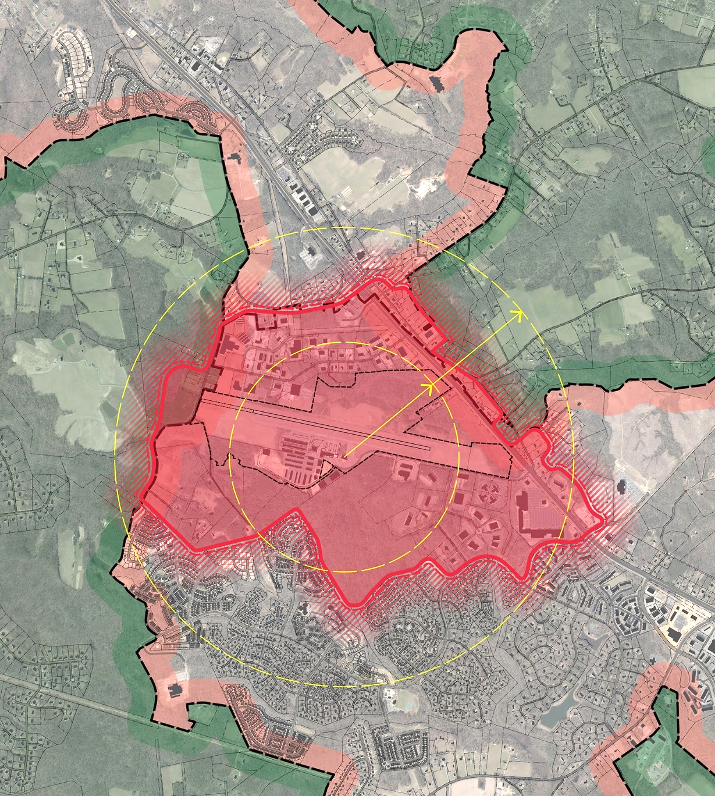
Proposed Innovation District Boundary
Good Visibility and Presence on 235 / Three Notch Rd.
Presents Cohesive and Unique Brand Identity along Major Regional Connector
Maintains Strong Focus on the Core Concept of Airport-Centered Innovation District
Incorporates Surrounding Adjacent Property with Opportunities for Supportive Development and Amenities
Geographic Boundaries reinforce Innovation District Identity
Good Size for Multi-Modal Transportation Network – Biking, Electric Personal Transit, Shuttles, and Walkable Street Network
235 / Three Notch Rd
1 Mile
½ Mile
11

Slide 12
Framework and Plan Elements
12

Slide 13
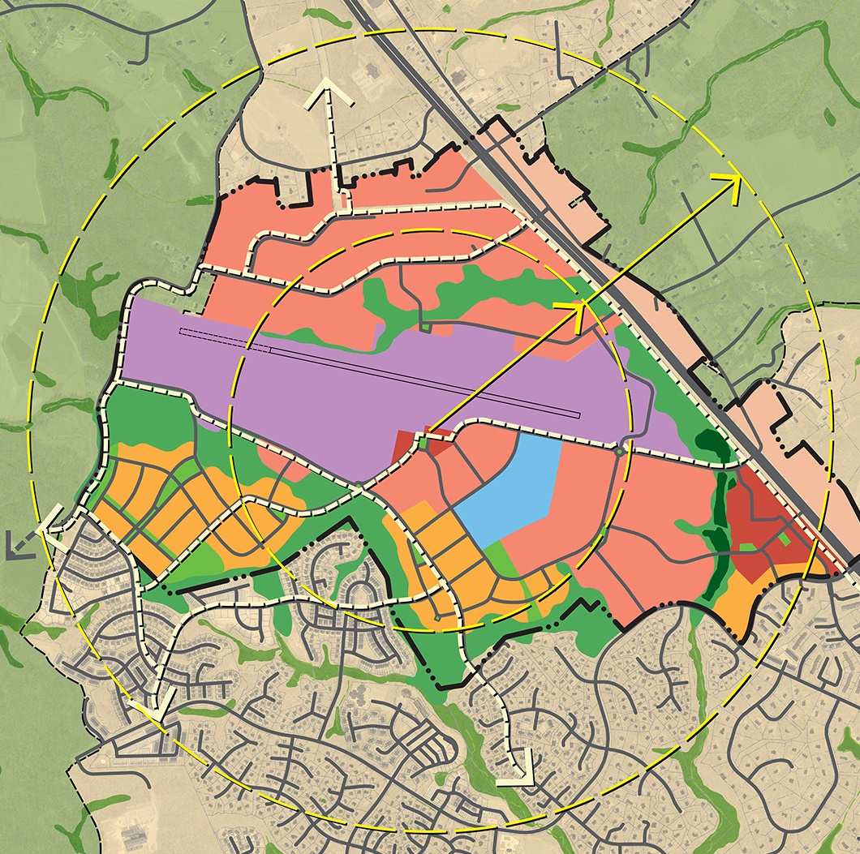
Key Elements
North Side Taxiway and Large-format Hangar Space
Innovation Square
West Hangar Expansion
Three Notch Road Airport Gateway
Three Notch Road Branding and Wayfinding Strategy
Innovation Village
Wildewood Shopping Center Potential Redevelopment
West Innovation Village
Manufacturing and Fabrication Zone
Transportation and Mobility Network
Programmatic and Management Activities
9
1
5
3
2
4
8
7
6
13

Slide 14
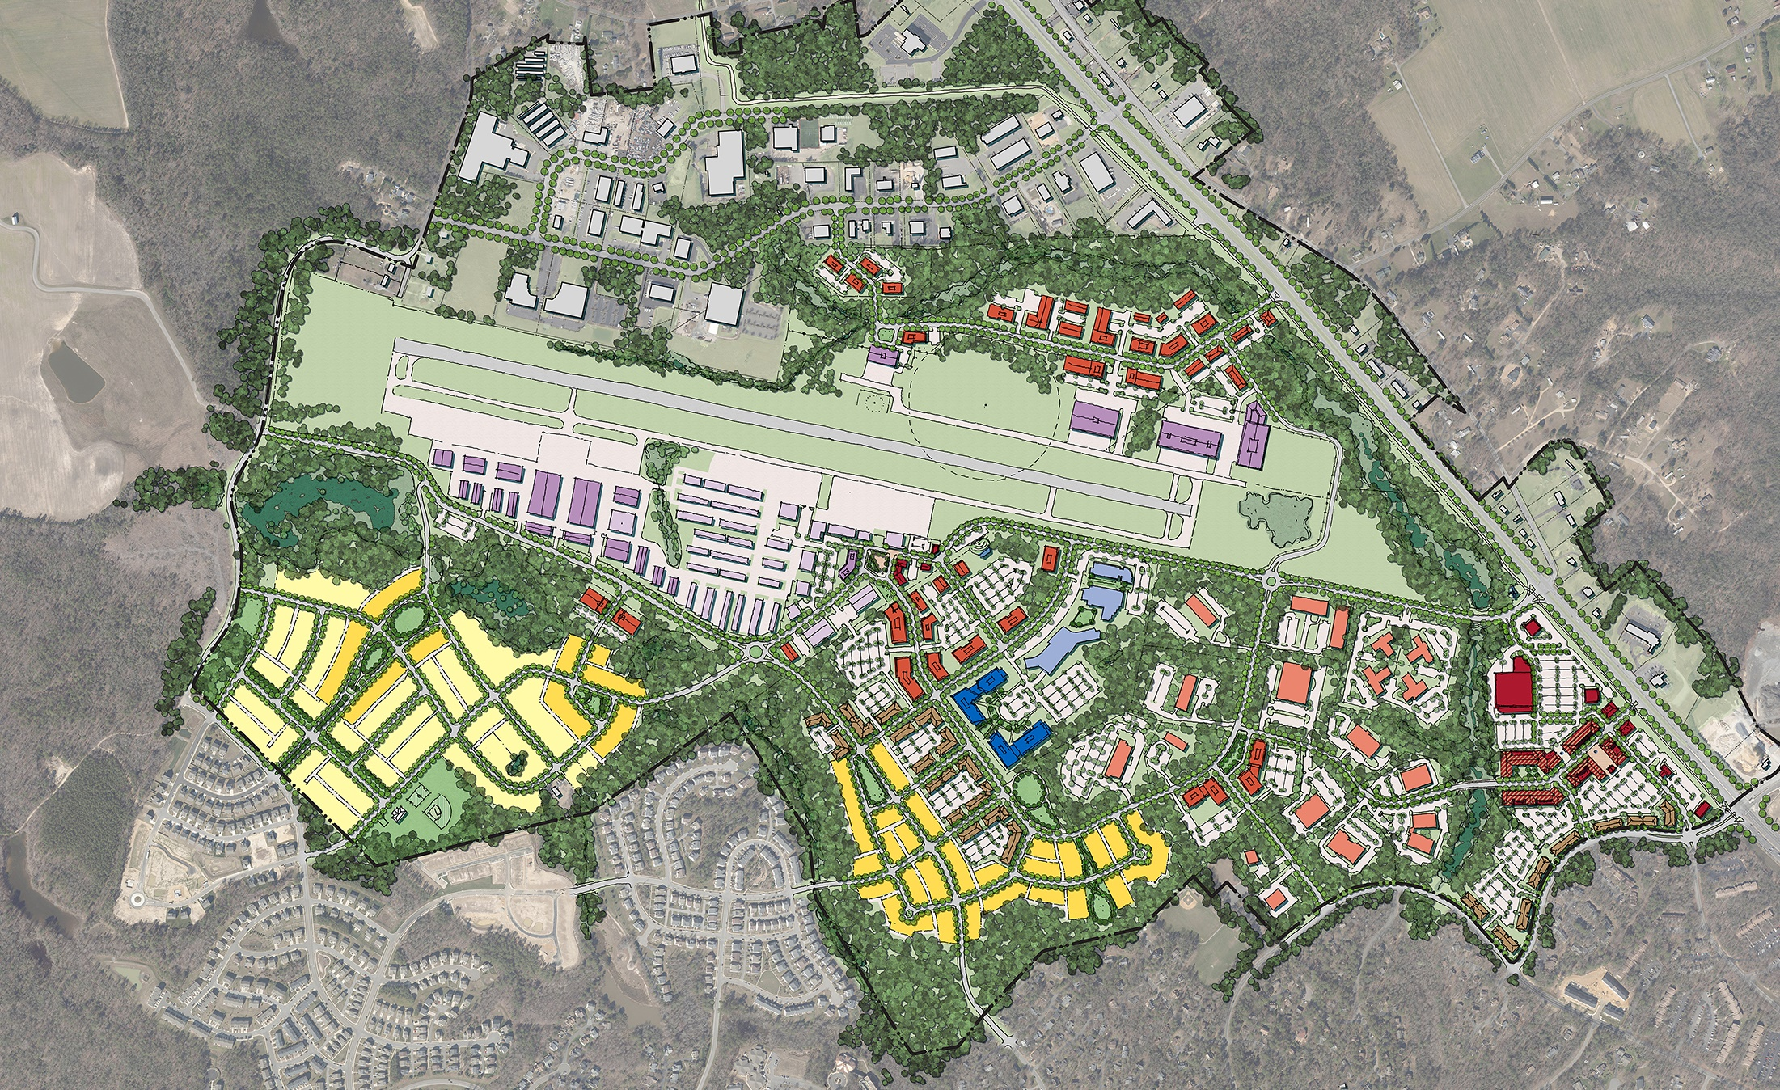
Core Area Plan and Key Elements
Lawrence Hayden Rd
Airport View Dr
235 / Three Notch Rd
Airport Rd
Lawrence Hayden Rd
Cottonwood Pkwy
Wildewood Pkwy
14

Slide 15
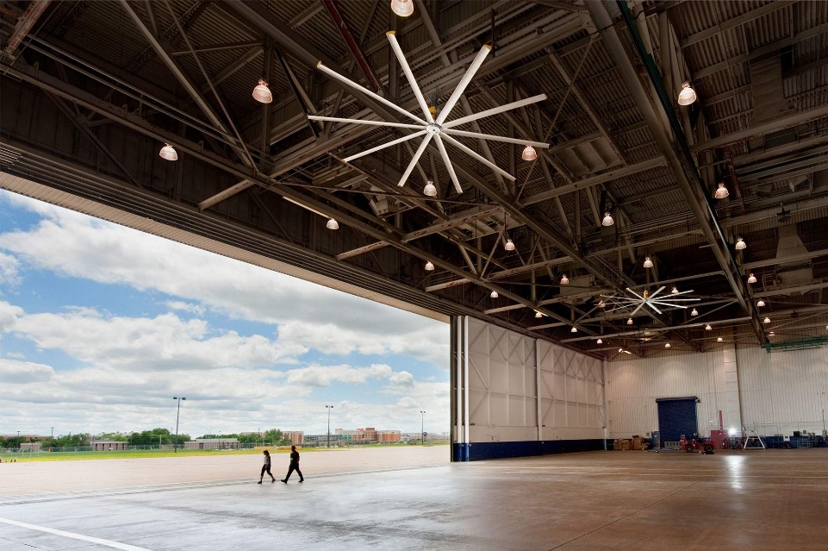
Core Area Plan and Key Elements
1. North-Side Taxiway and Large-format Hangar Space
Lawrence Hayden Rd
Airport View Dr
New Road
235 / Three Notch Rd
Airport Rd
New Taxiway on North Side
Opportunity for Larger Hangars
Coordinated with Existing AWOS
New Access Road Connecting Airport View Dr and 235
Possible New Connection to Airport Rd
15

Slide 16
Core Area Plan and Key Elements
2. Innovation Square
Lawrence Hayden Rd
Airport View Dr
235 / Three Notch Rd
Airport Rd
Lawrence Hayden Rd
16

Slide 17
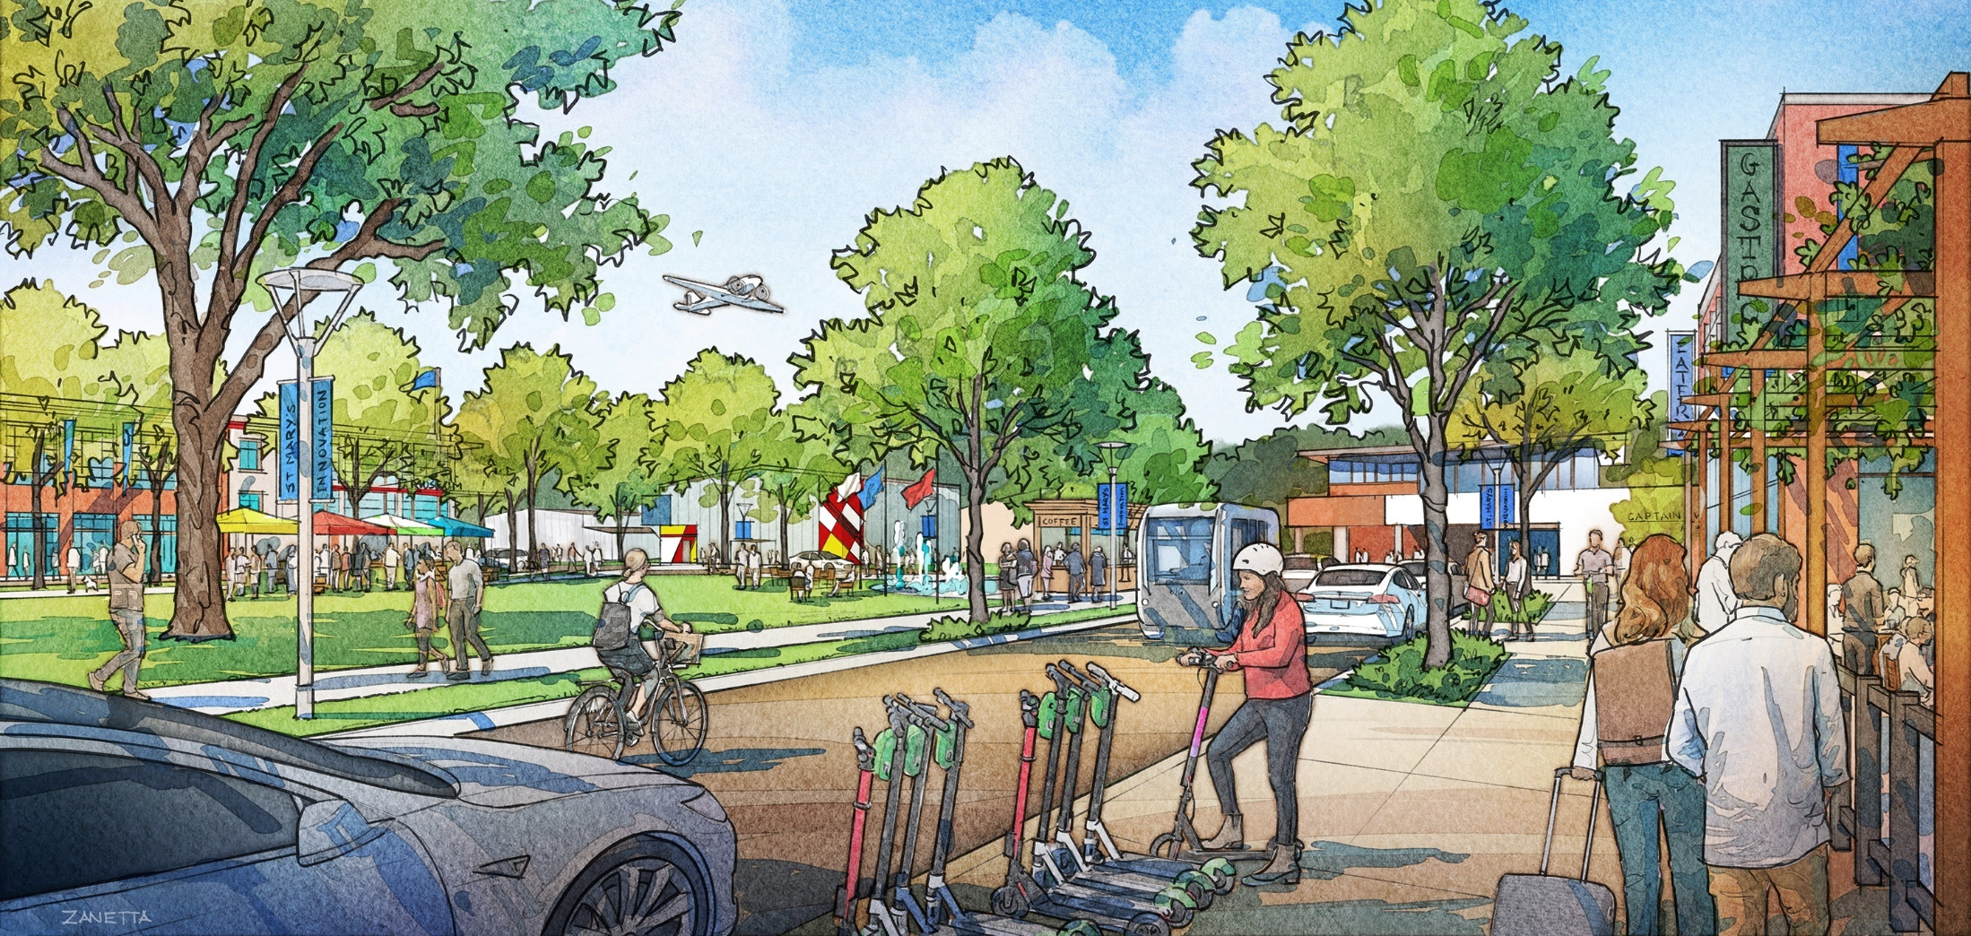
Innovation Square

Slide 18
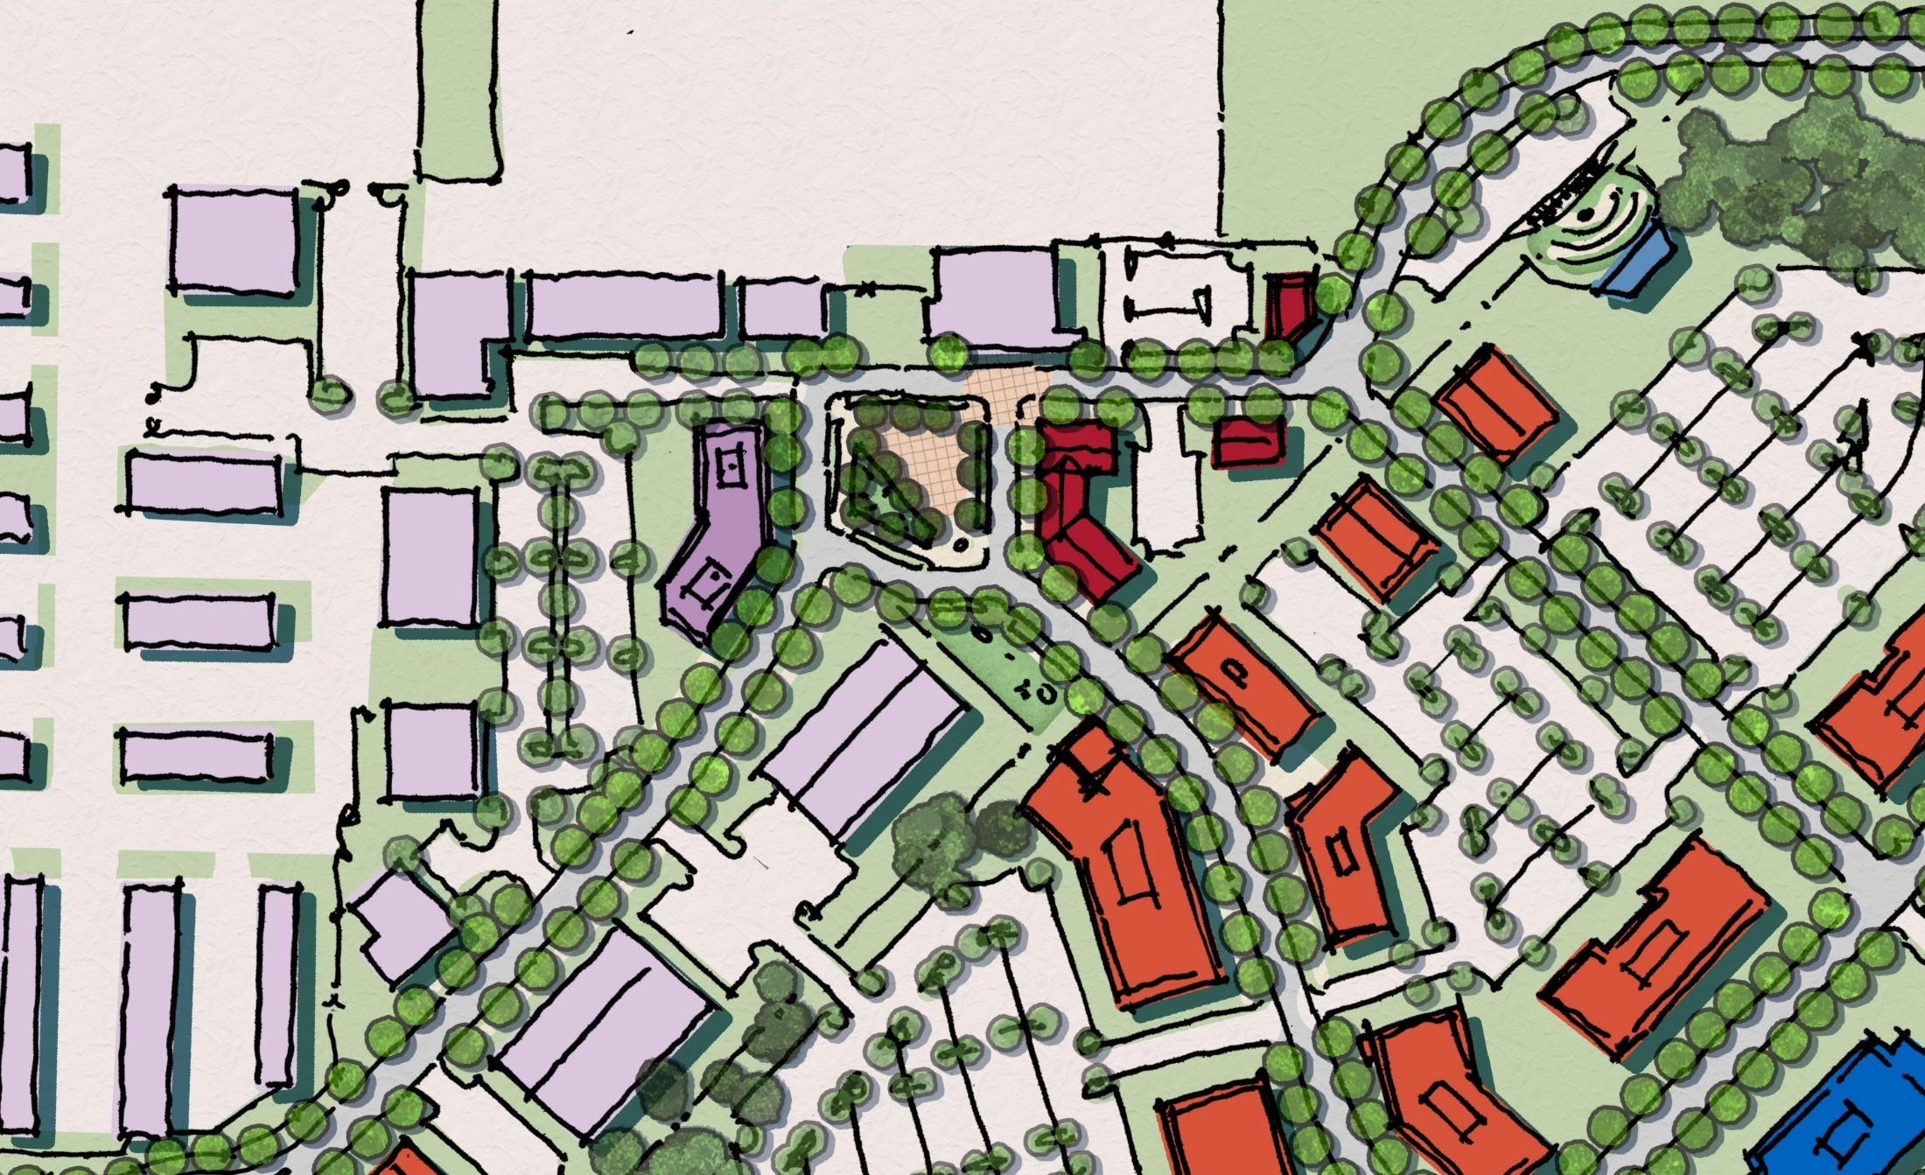
Core Area Plan and Key Elements
Airport Rd
Terminal
Museum / Conf. Space
Observation Area
UMD UAS Test Site
Restaurant / Brewery / Cafe
Expanded Parking Lot
TechPort
New Connections to Surrounding Property
18

Slide 19
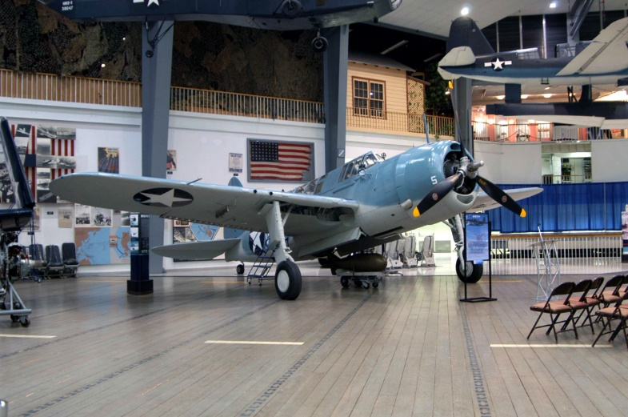
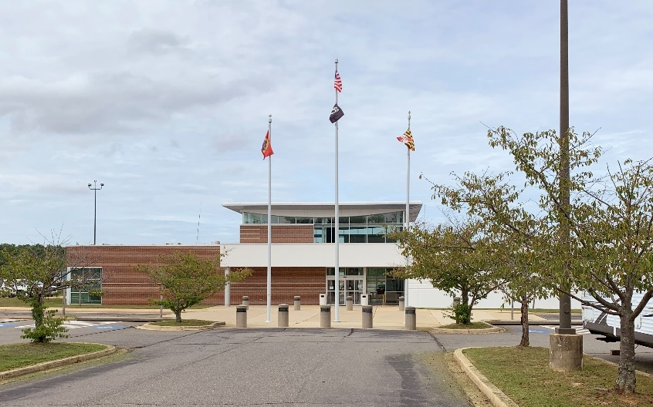
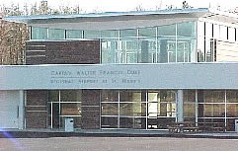
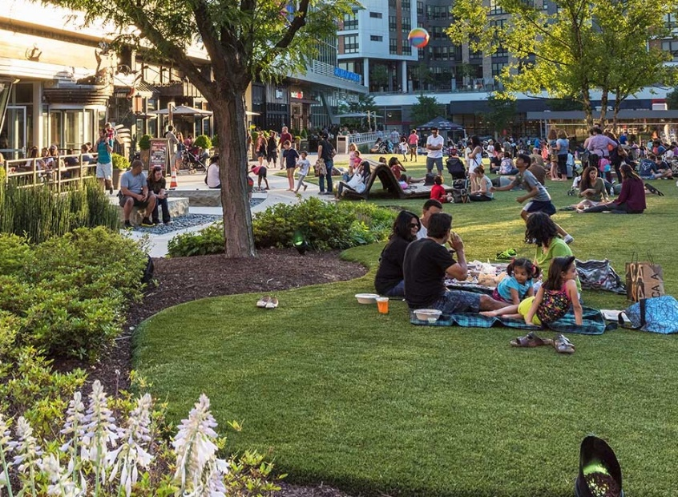
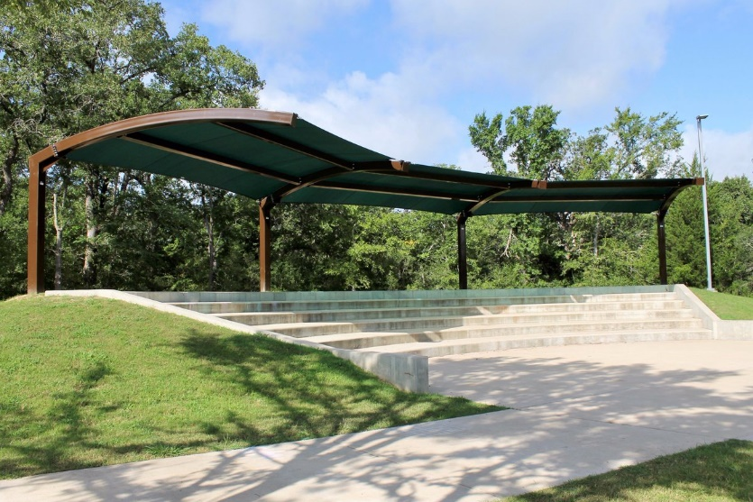
Core Area Plan and Key Elements
Museum and Meeting Space
Expanded Services at Terminal
Airplane Observation Area in Hillside Overlooking Runway
New Square and Gathering Space
19

Slide 20
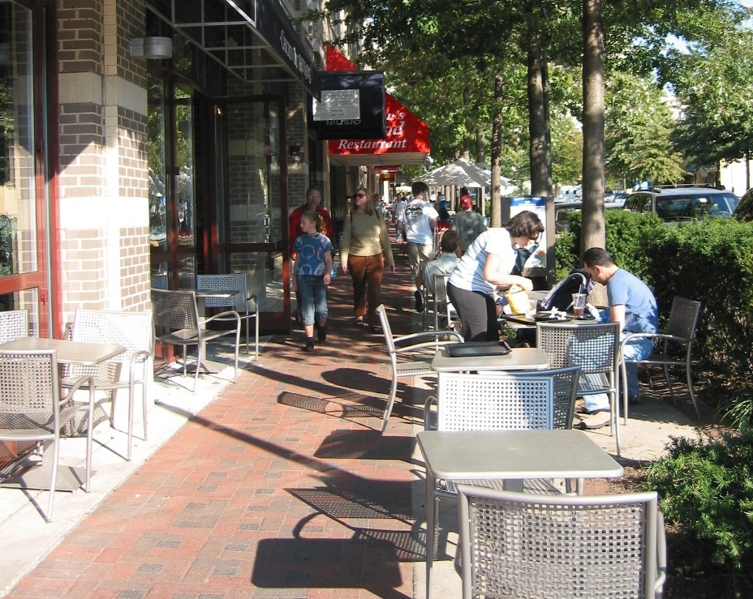
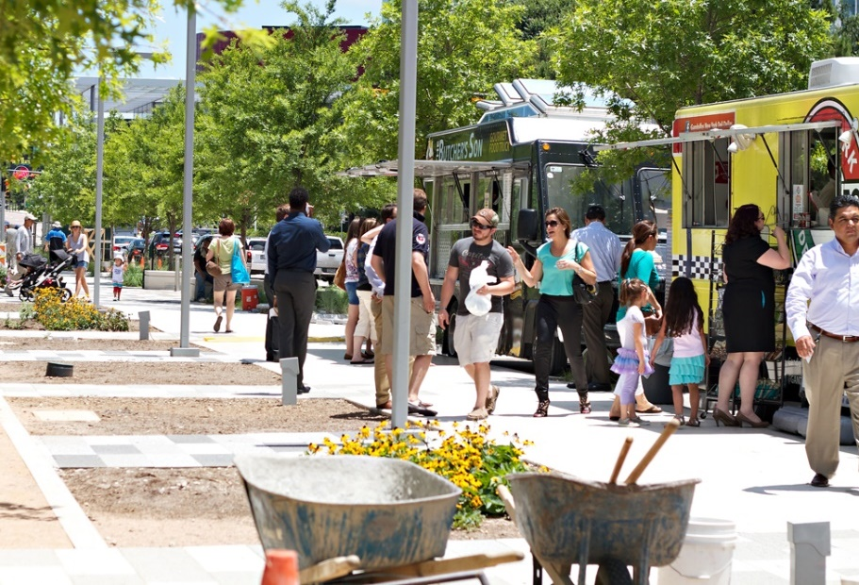
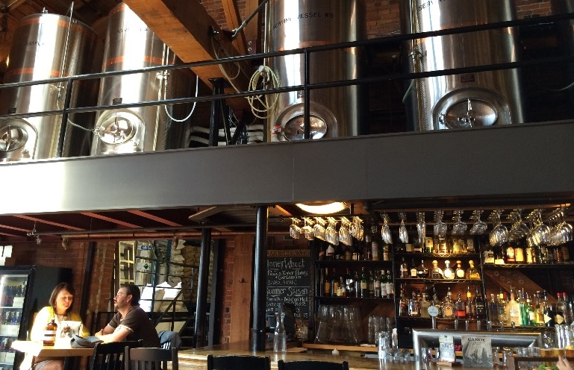
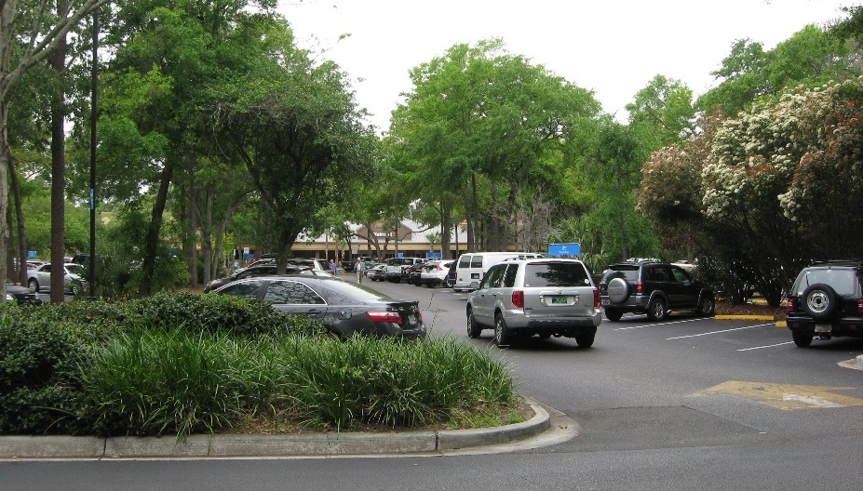
Core Area Plan and Key Elements
Popup Events / Food Trucks
Mixed-Use Streetscape
New and Expanded Parking Areas
Destination Restaurant / Brewery
20

Slide 21
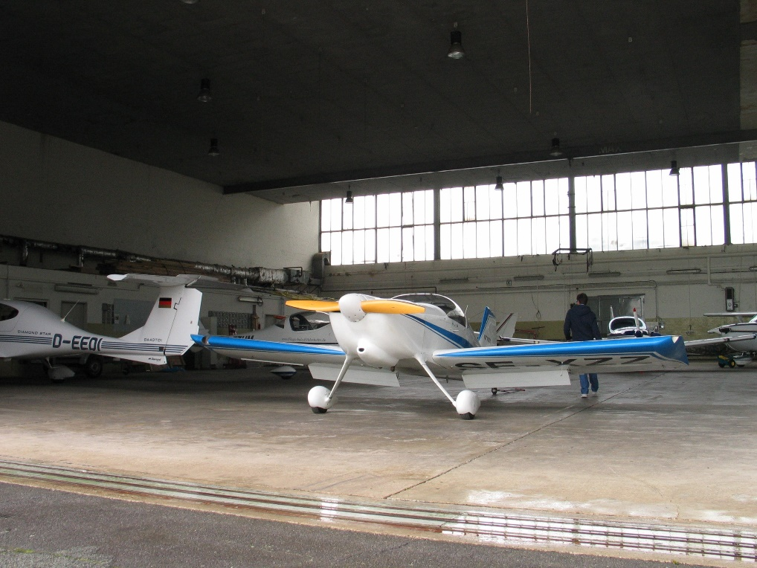
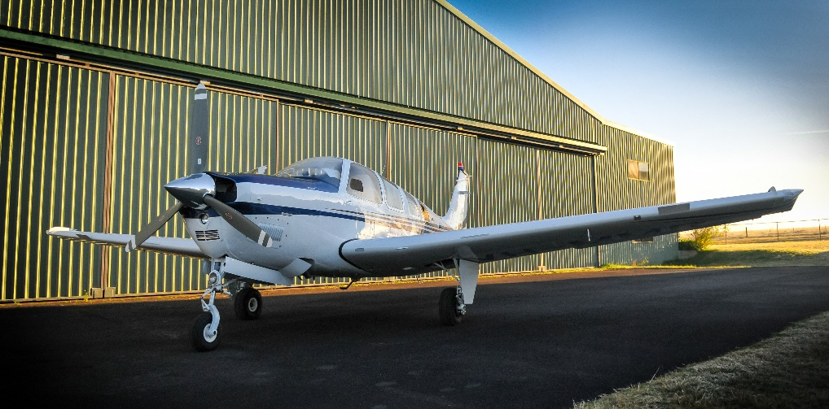
Core Area Plan and Key Elements
West Hangar Expansion
Lawrence Hayden Rd
Airport View Dr
Align New East/West Road Closer to South Property Line
Create more Space “Inside the Fence” for Hangars with direct Taxiway Access
21

Slide 22
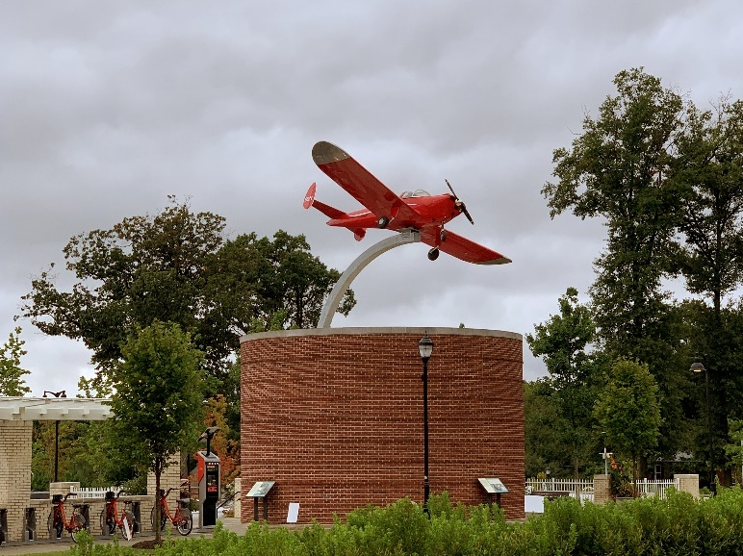
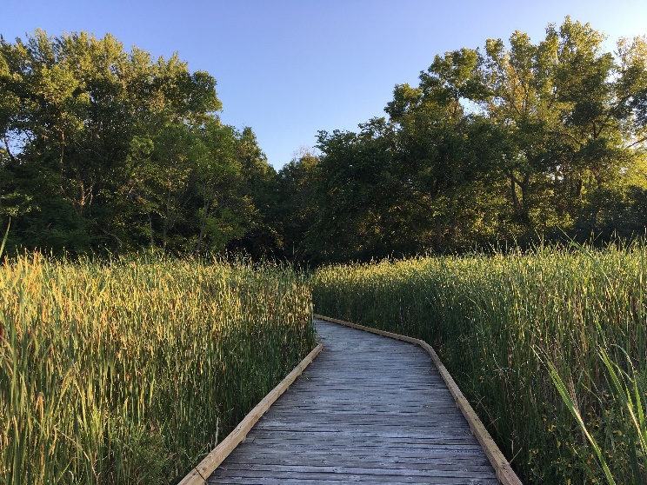
Core Area Plan and Key Elements
4. Three Notch Road Airport Gateway
235 / Three Notch Rd
Airport Rd
Aviation Monument at Entrance
Interpretive trail in St. Mary’s River Headwaters / Wetlands
22

Slide 23
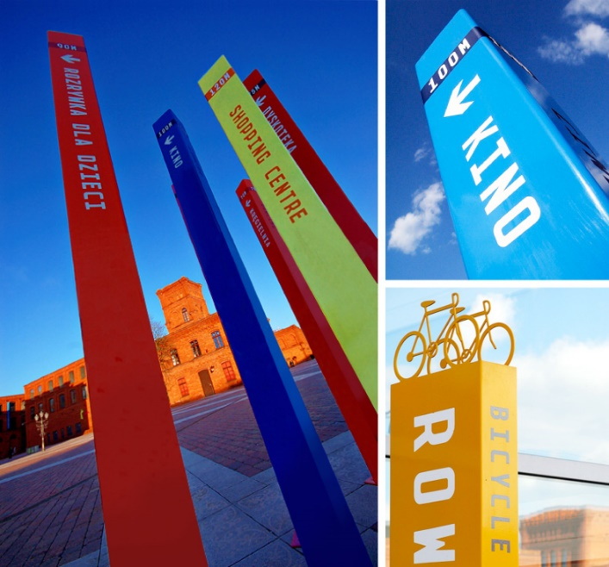
Core Area Plan and Key Elements
5. Three Notch Road Branding and Wayfinding Strategy
235 / Three Notch Rd
Airport Rd
Create Unified Branding and Wayfinding Strategy for Innovation District
Banners, Lighting, Signage, Art, and Furniture
Streetscape Design on 235 Increases Visibility
23

Slide 24
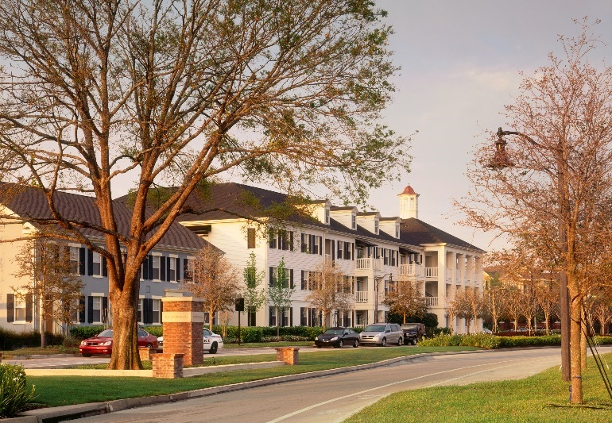
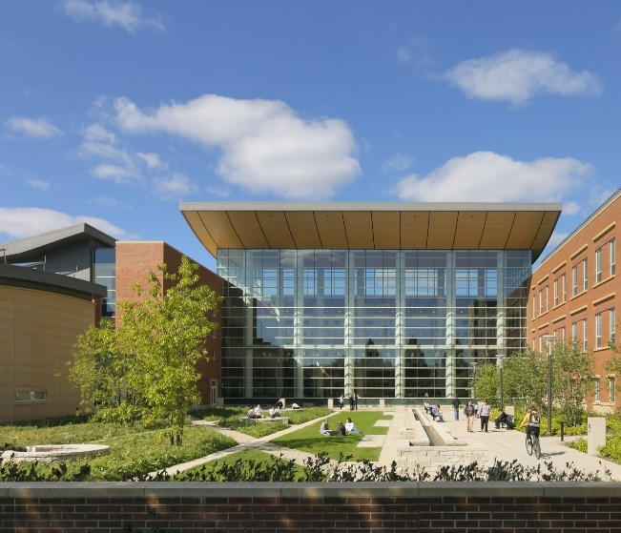
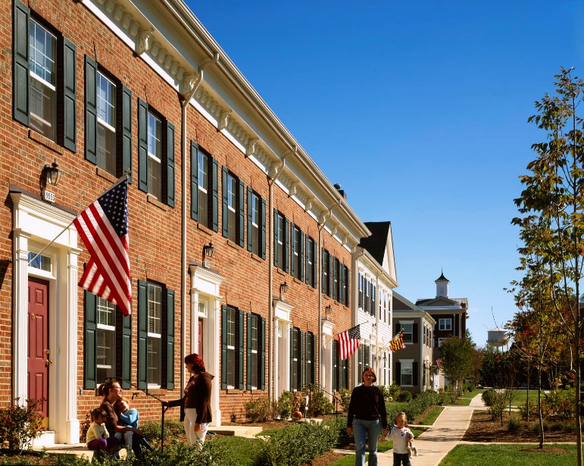
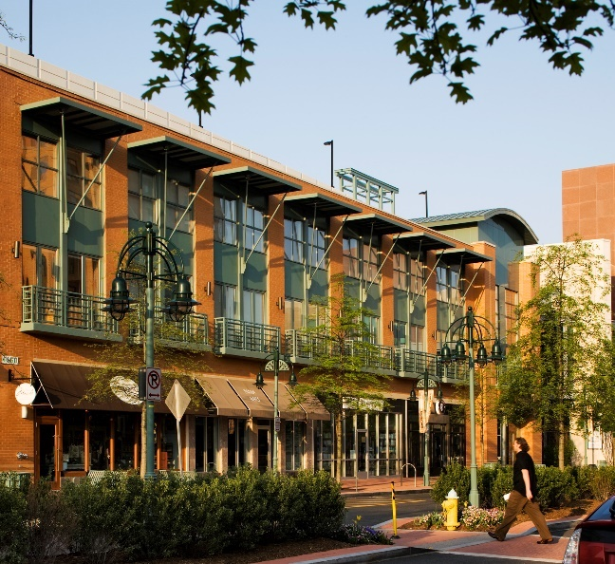
Core Area Plan and Key Elements
6. Innovation Village
24

Slide 25
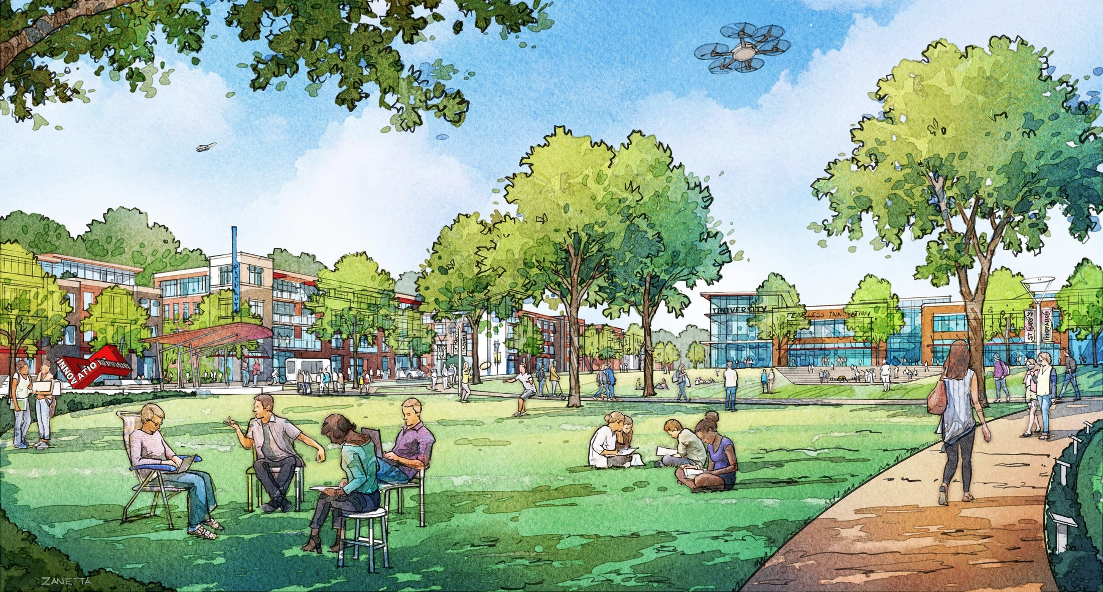
Innovation Village Park

Slide 26
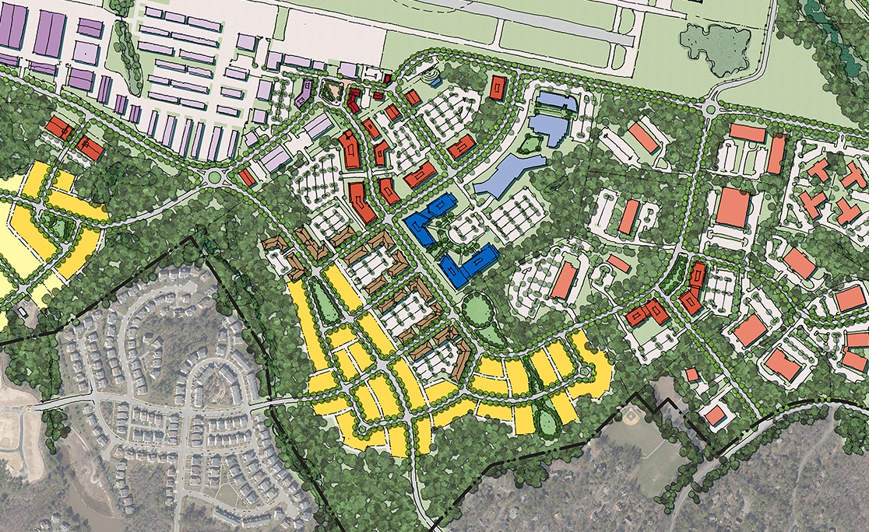
Core Area Plan and Key Elements
Mixed-Use Innovation Village
Live, Work, Learn, Play, and Innovate on Site
Innovation Square
New Flex / Commercial / Office Space
Airport Rd
Cottonwood Pkwy
USMSM Expansion
Smoke Hill Rd
IMPAX
Tallwood Dr
Residential Neighborhood
Wildwood Pkwy
Possible Connections to Neighboring Properties
26

Slide 27
Core Area Plan and Key Elements
7. Wildewood Shopping Center Redevelopment Opportunity
Lawrence Hayden Rd
235 / Three Notch Rd
Airport Rd
Cottonwood Pkwy
27

Slide 28
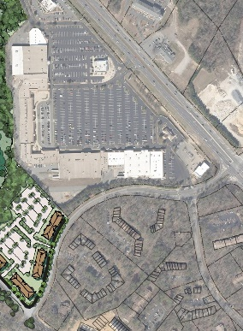
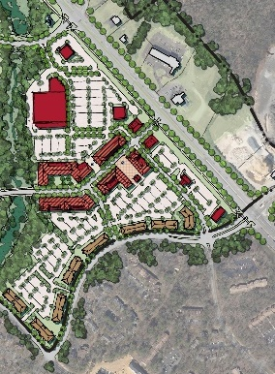
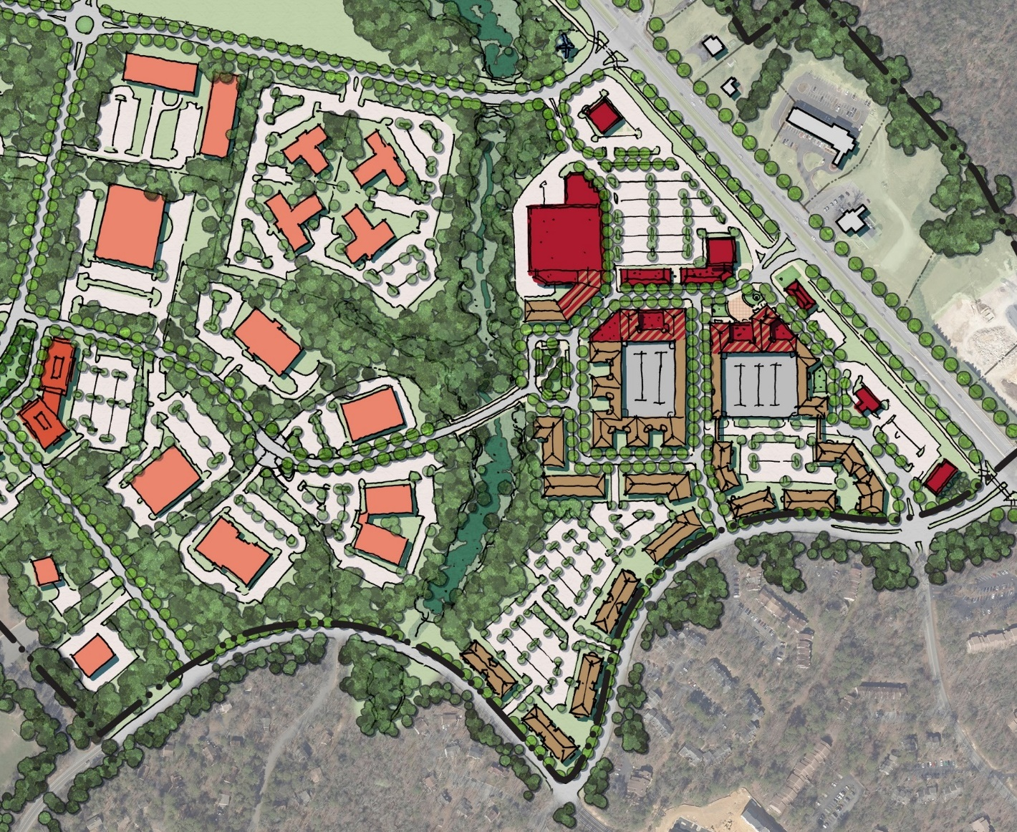
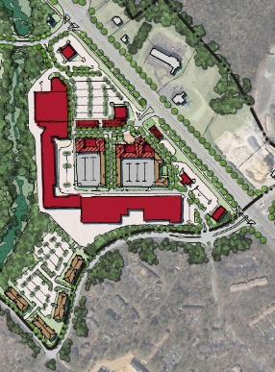
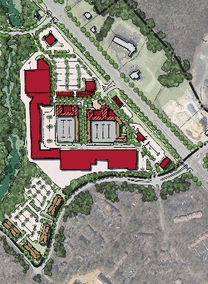
Redevelopment Scenarios
Airport Rd
Existing Department Store
Existing Pad Sites
Mixed-Use “Main Street” Residential over Retail
Cottonwood Pkwy
235 / Three Notch Rd
Infill Blocks w/ Replacement Parking
Proposed Crossing and Connection to Innovation Village
Smoke Hill Rd
Wildewood Blvd
New Multifamily Housing
Wildewood Pkwy
28

Slide 29
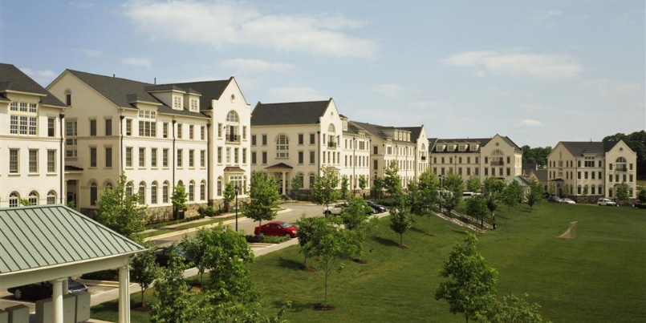
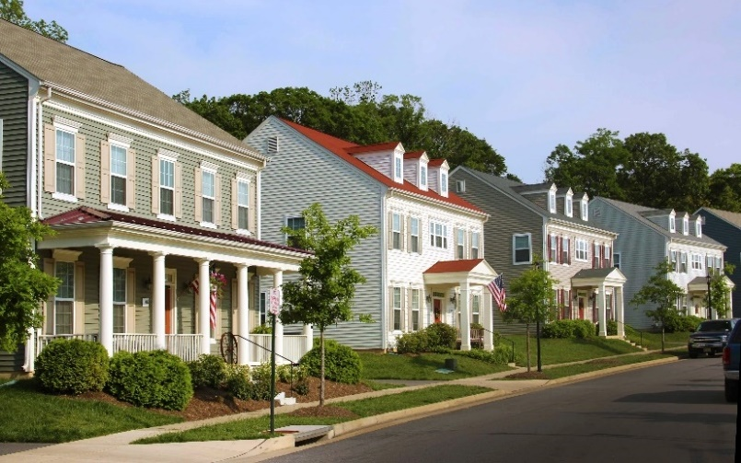
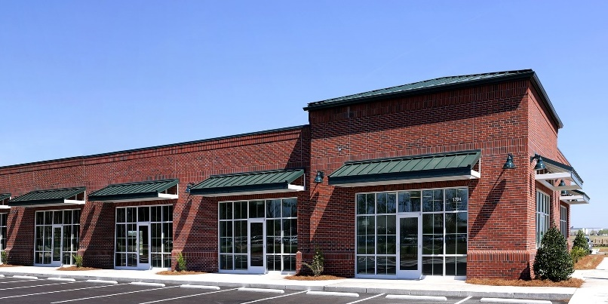
Core Area Plan and Key Elements
8. West Innovation Village
Limited Flex Development due to Wetlands and Forest Conservation Areas
Additional Housing to meet Needs of Innovation District and County
Lawrence Hayden Rd
Primevere Dr
29

Slide 30
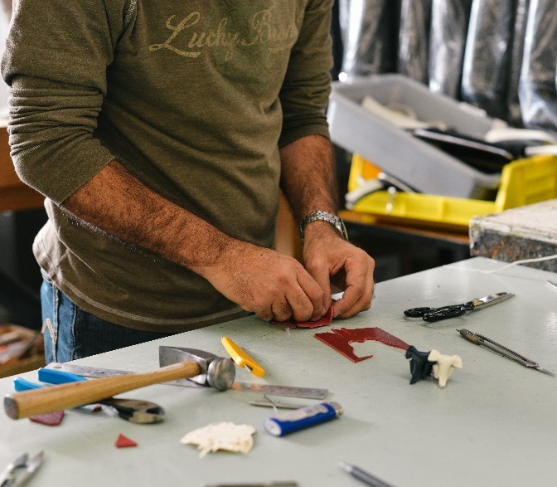
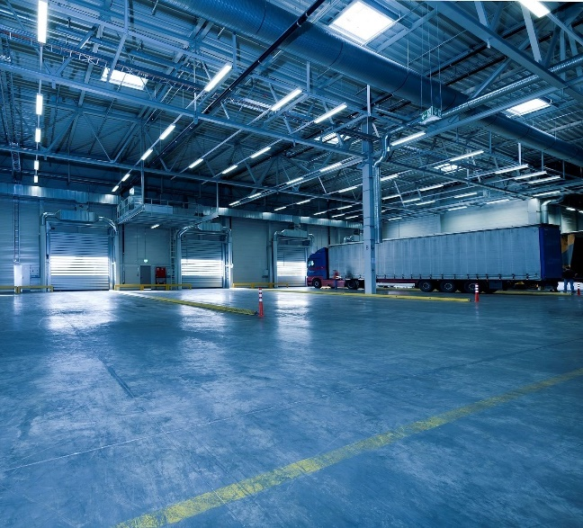
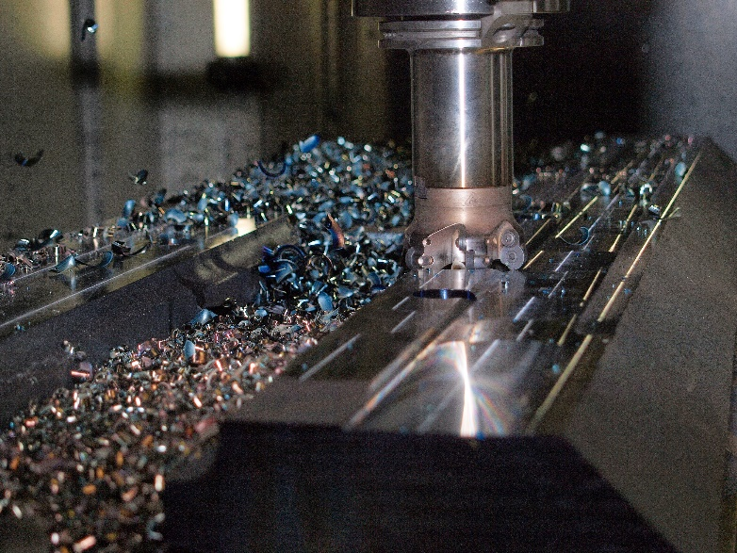
Core Area Plan and Key Elements
9. Manufacturing and Fabrication Zone
Firms and Facilities for High-Tech Industries
Linked to Innovation Village through Digital Infrastructure and Mobility Network
235 / Three Notch Rd
Airport View Dr
Lawrence Hayden Rd
30

Slide 31
Core Area Plan and Key Elements
10. Transportation and Mobility Network
Make Connections to Surrounding Development
Support Mobility of Innovation District Workers, Guests, and Neighbors
All Streets Should be Designed for Walkability and Active Transit
31

Slide 32
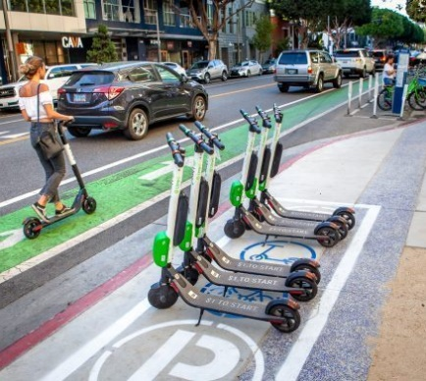
Transportation & Mobility Options: Walking, Biking, Micro-Mobility
Sidewalks provide healthy alternative mode of transportation and increase safety
Biking facilities provide healthy alternative mode of transportation, encourage use, and increase safety
Transportation is in a paradigm shift and we must plan for what the street will be in 10 years.
New mobility devices are designed to make the last mile trips faster, more comfortable, and a logical choice over a personal vehicle
32

Slide 33
Street Typology
33

Slide 34
Core Area Plan and Key Elements
11. Programmatic/Management Activities and Implementation
Innovation District Management
Educational Programs - Primary, High School, and Vocational
Regular Social Events for Innovation District Workers and Firms
Innovation District Expo
Tours, Demonstrations, and Events that Show Off What’s Happening
Flight Museum
Observation Area for Watching Runway
Coordinate Policy and Regulations that Permit Implementation and Ensure Delivery of Vision
34

Slide 35
St. Mary’s County Airport Innovation District Master Plan
The Commissioners of St. Mary’s County
Calvert-St. Mary’s Metropolitan Planning Organization
November 5, 2019
Torti Gallas + Partners
Toole Design Group

